Slide 1
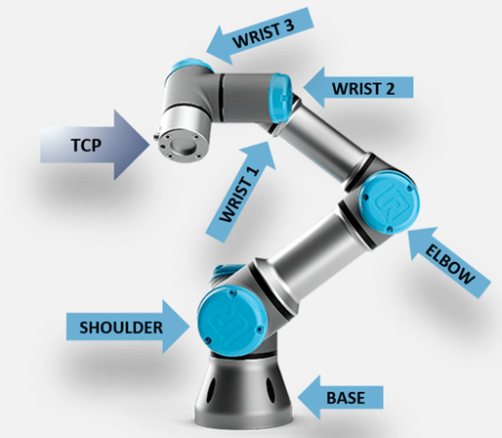
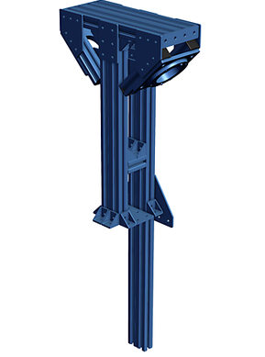
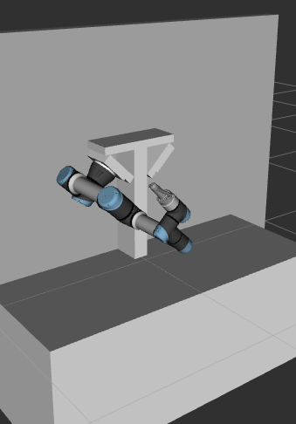
UR5e and environment
pdf datasheet: https://www.universal-robots.com/media/1807465/ur5e_e-series_datasheets_web.pdf
user manual (ITA): https://s3-eu-west-1.amazonaws.com/ur-support-site/50567/UR5e_User_Manual_it_Global.pdf
vention website: https://vention.com/designs/dual-ur5-workstation-127088

Slide 2
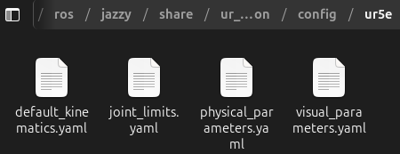
Already known parameters
from ros2 package: ur_description
1 - kinematics (DH table)
2 - joint position and velocity limits
3 - inertial parameters
4 - meshes
however we used: uclv_left_ur5e_kinematics.yaml (calibration)
repo: https://github.com/UniversalRobots/Universal_Robots_ROS2_Description/tree/jazzy
installing apt: sudo apt install ros-jazzy-ur-description

Slide 3
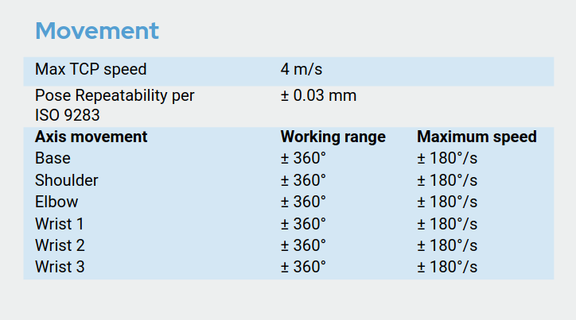
Speed and position limits
*
source: https://www.universal-robots.com/media/1807465/ur5e_e-series_datasheets_web.pdf

Slide 4
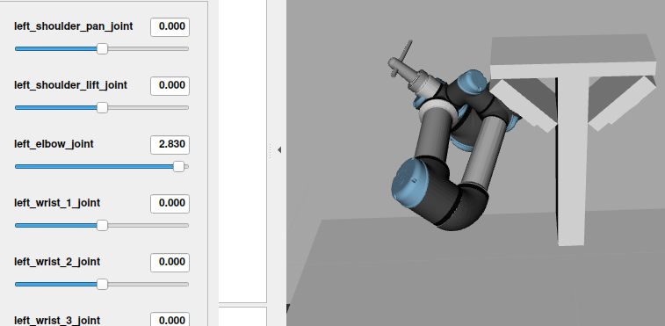
Speed and position limits
*but...
when elbow = ±π $$→$$ collision!!
so.. we limit it to [-π, +π]

Slide 5
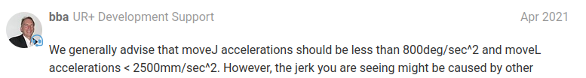
Acceleration limits
we found on the official forum..
Max Joint Acceleration | Max Cartesian Acceleration
800 °/$$s^{2}$$ | 2.5 m/$$s^{2}$$
source: https://forum.universal-robots.com/t/maximum-axis-speed-acceleration/13338

Slide 6
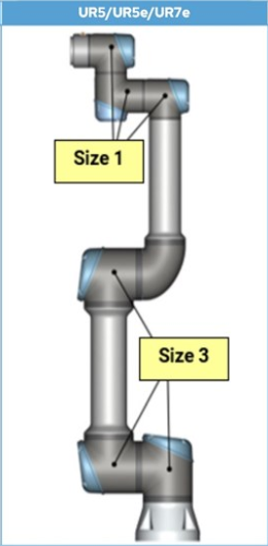
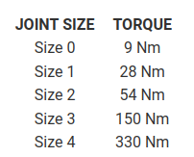
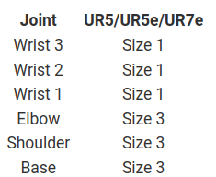
Torque limits
source: https://www.universal-robots.com/articles/ur/robot-care-maintenance/max-joint-torques-cb3-and-e-series/

Slide 7
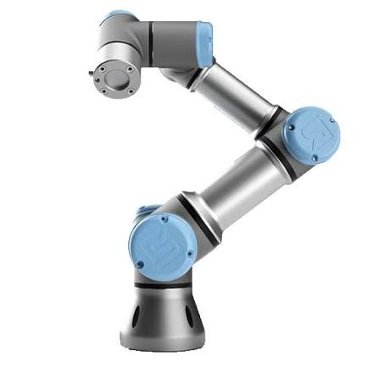
Actuators modeling
Rotor inertia | 0.1 kg $$m^{2}$$
kp, kv Size1(small joints) | kp=500 kv=100
kp, kv Size3 (big joints) | kp=2000 kv=400
Torque limits | ..see previous slide
source: https://github.com/google-deepmind/mujoco_menagerie/tree/main/universal_robots_ur5e

